Slide 1
ACCIDENTS HAPPEN. OR DO THEY?
By: Mike Bertsch
Nicola, Gudbranson & Cooper, LLC

Slide 2
OOPS!

Slide 3
OOPSIE!

Slide 4
PRATFALL EFFECT:
Bumbling that makes you more human, and thereby more likeable!

Slide 6
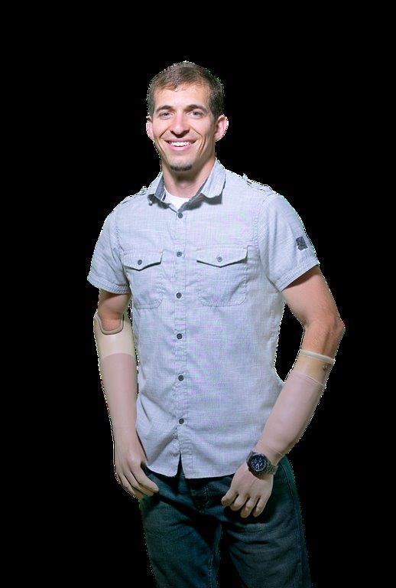

Slide 8
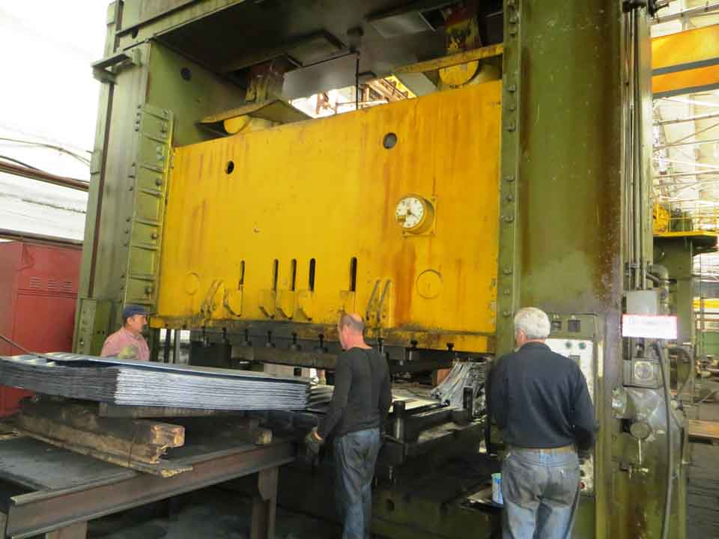

Slide 9
500 TON STAMPING PRESS

Slide 10
POTENTIAL LIABILITIES
OSHA
BWC/ICO
EMPLOYER INTENTIONAL TORT

Slide 11
OSHA
29 C.F.R. 1910.217 – Mechanical Power Press Guarding
Effective vs. Fool Proof
Classifications
Willful
Repeat
Serious

Slide 12
OSHA
29 C.F.R. 1904.39 – Accident Reporting
Death
In-patient Hospitalization
Amputation
Eye Loss
Failure to Report: $5-7,000 fine in 24 hours/8 death

Slide 13
OSHA VISIT
1) NO WARRANT
2) WARRANT

Slide 14
BWC/ICO
Workers Compensation Claim
Medical
Lost Time
Loss of Use Award
450 weeks x $902.00 per week = $405,900 (2017)

Slide 15
VSSR
Violation of A Specific ICO Regulation
Penalty
Award 15-50% of Comp Paid and Payable at Max Rate
No Insurance and Direct Loss
Not Limited to 5 year experience

Slide 16
EMPLOYER INTENTIONAL TORT
OHIO REVISED CODE § 2745.01
DIRECT ACTION – NOT W.C.
“Deliberate” Intent to Injury Only
“Deliberate” Removal of Safety Guard

Slide 17
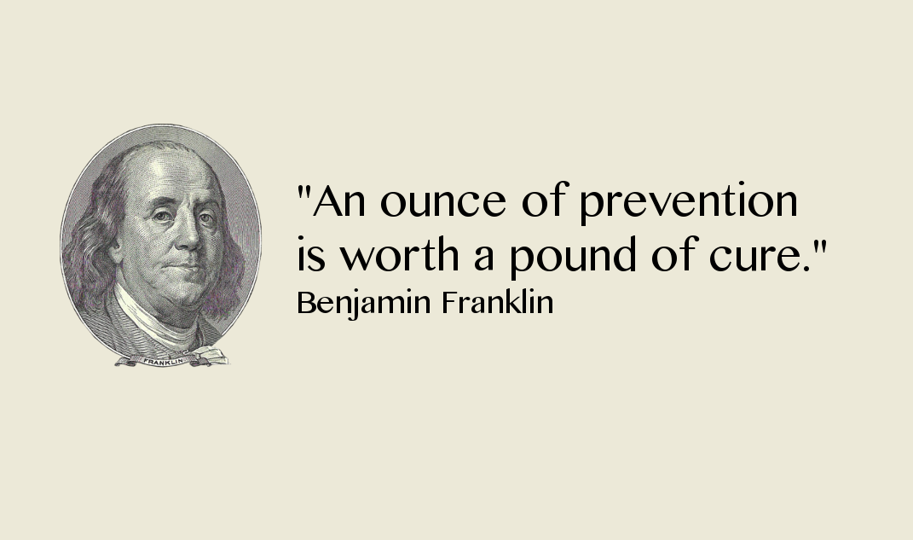

Slide 20
THE END

Slide 21
?

